Slide 1
Unit 6 Part 1 Advanced Product Management in Agile

Slide 2
Product Strategy in Agile
Definition: A clear plan aligning product development with business goals.
Key Components: Vision, Roadmap, Goals, KPIs.
Agile Product Strategy: Adaptive planning, iterative development, and early delivery.

Slide 3
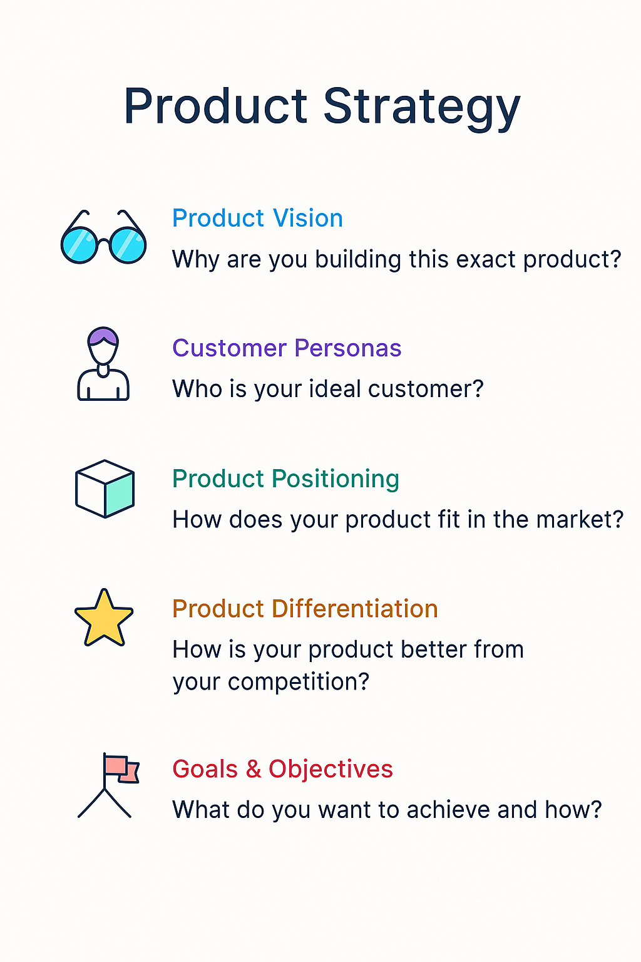

Slide 4
Understanding Product-Market Fit
Product-Market Fit: When your product satisfies a strong market demand.
Indicators: High user retention, organic growth, and customer satisfaction.
Importance: Validates problem-solution alignment.

Slide 5
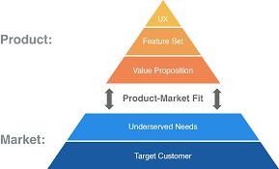

Slide 6
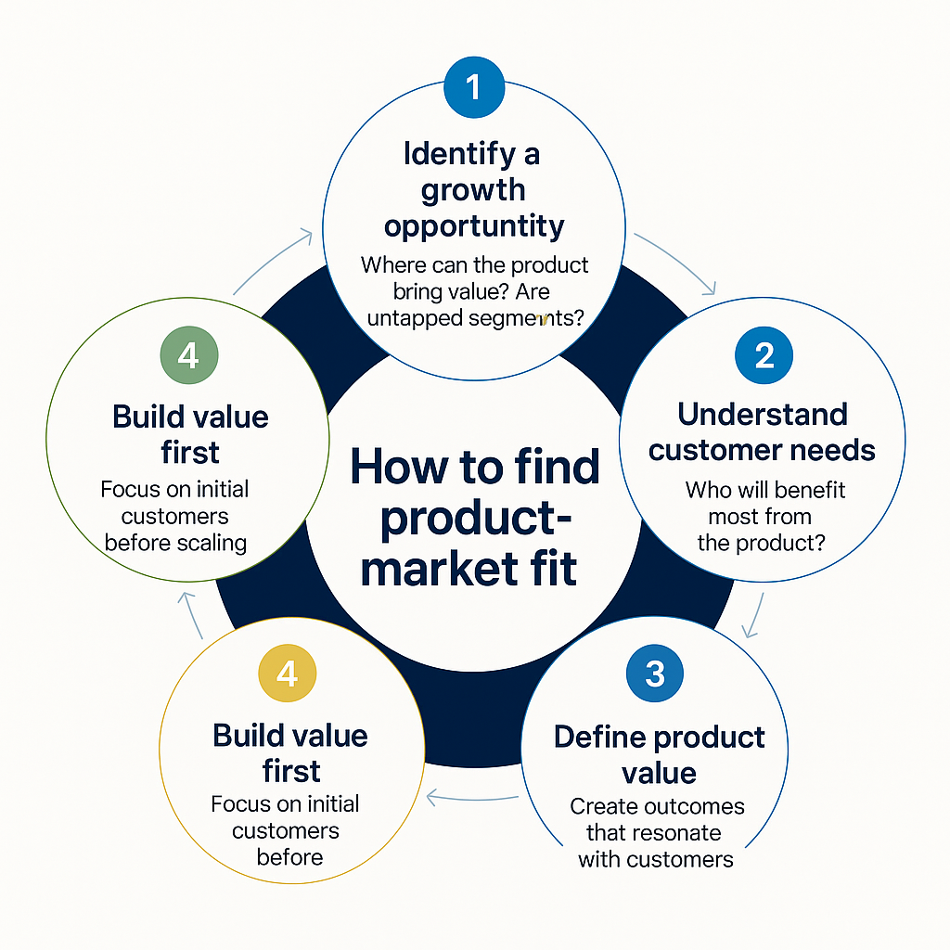

Slide 7
Data-Driven Product Decisions
Leverage analytics tools to guide features and improvements.
Use KPIs like DAU, MAU, churn rate, NPS(Net Promoter Score).
Benefits: Minimizes bias, increases customer alignment.

Slide 8
Use KPIs like DAU, MAU, Churn Rate, NPS
DAU (Daily Active Users): Measures how many unique users engage with your product on a daily basis
. This metric shows how often users return to your platform and can be a sign of product engagement.
MAU (Monthly Active Users): Similar to DAU, but over a longer period (monthly). This helps measure long-term engagement and the growth of your user base.
Churn Rate: The percentage of users who stop using your product during a given time period. A high churn rate indicates dissatisfaction or a lack of retention, signaling the need for improvements.
NPS (Net Promoter Score): A measure of customer satisfaction and loyalty. It indicates how likely users are to recommend your product to others, which is a strong indicator of product quality and user trust.

Slide 9
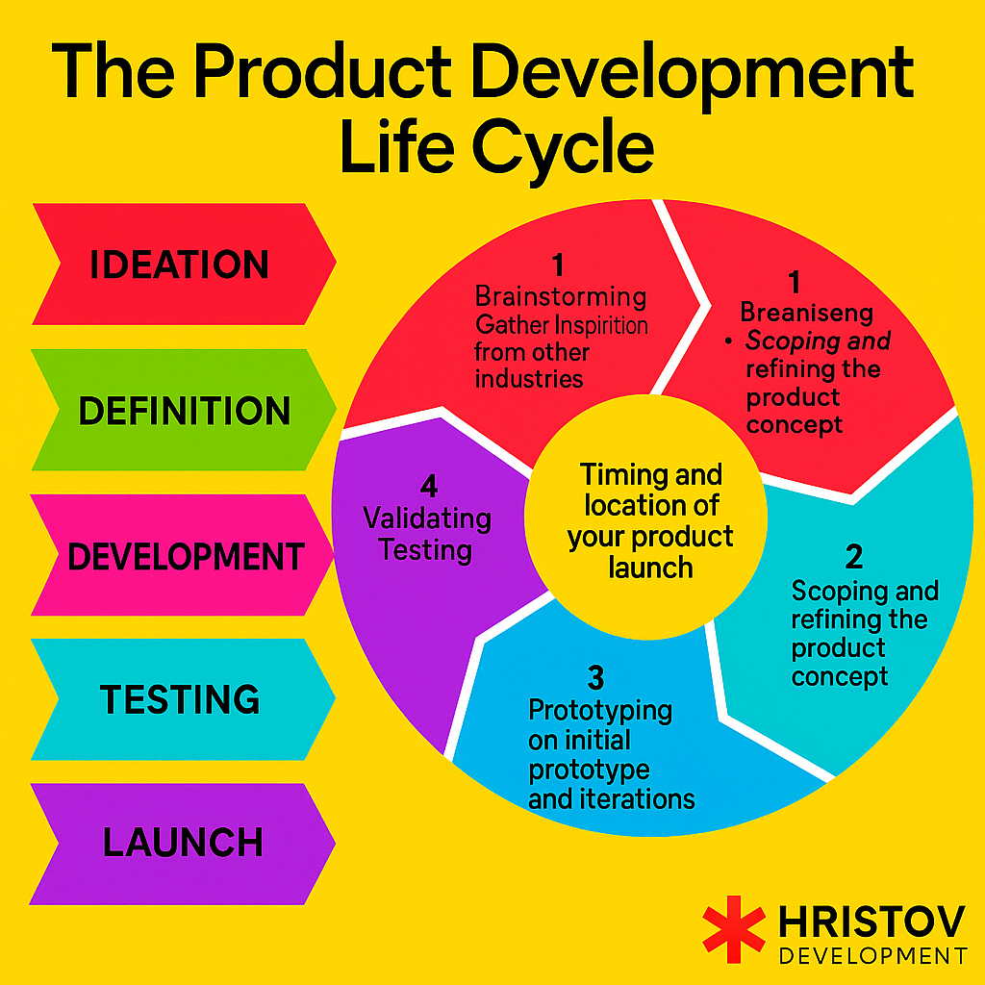

Slide 10
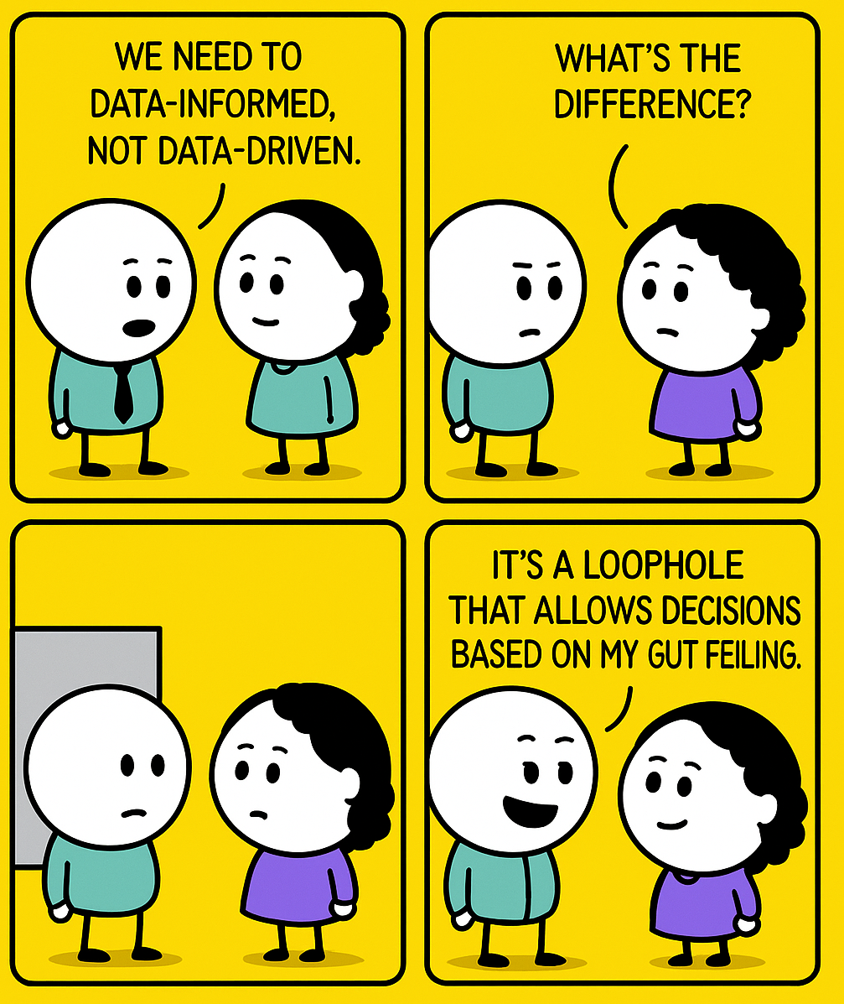

Slide 11
A/B Testing in Product Management
Definition: A method to compare two versions of a feature.
Use Cases: UI changes, pricing, feature engagement.
Best Practices: Define hypothesis, control variables, analyze data statistically.

Slide 12
A/B Testing in Product Management
Definition:
A/B testing is a controlled experiment that compares two versions of a feature, design, or element to determine which one performs better. It helps in making data-driven decisions for improving a product. In this method, users are randomly assigned to one of the two versions, and their behaviors are tracked and analyzed to measure the performance of each variant.
A: The current version of the feature (often referred to as the "control").
B: The modified version of the feature (the "variant" or "treatment").
By comparing user interactions, businesses can determine which version produces better outcomes based on predefined metrics like conversion rates, engagement, or user satisfaction.

Slide 13
Use Cases:
A/B testing is commonly used to evaluate the effectiveness of changes to a product. Some key use cases include:
UI Changes: Testing small tweaks to the user interface, like button color, text size, or layout. For instance, testing if a blue button leads to higher clicks than a red one.
Pricing: Comparing different pricing models (e.g., a subscription price of $9.99 vs. $14.99) to determine which results in higher sales or customer retention.
Feature Engagement: Introducing a new feature or change and measuring how it impacts user engagement, like testing a new notification feature to see if it increases daily active users (DAU).

Slide 14
Best Practices for A/B Testing:
ChatGPT said:
Define a Hypothesis: Before an A/B test, clearly define your hypothesis. For example, "Changing the 'Buy Now' button from green to red will increase click-through rates by 5%." This gives direction to the test.
Control Variables: Isolate the tested variable, ensuring other factors like timing, demographics, or device types remain consistent. This ensures the results reflect the effect of the specific change.
Analyze Data Statistically: Use statistical methods like p-values and confidence intervals to assess whether differences between A and B are significant. Ensure the sample size is large enough and the test duration is long enough to account for variations.

Slide 15
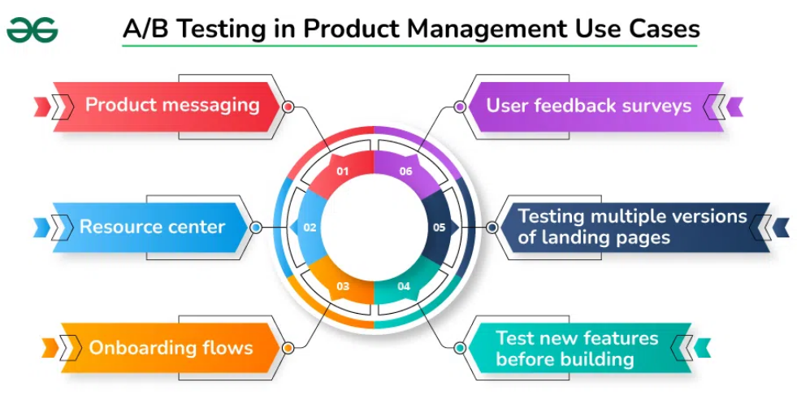

Slide 16
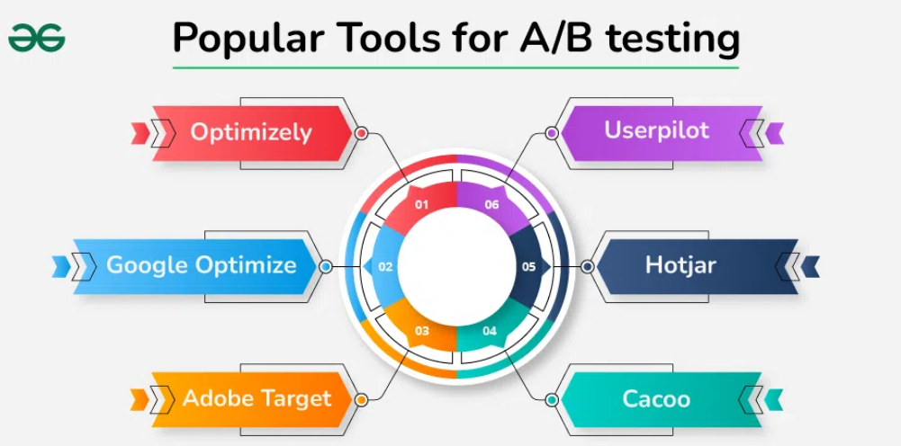

Slide 17
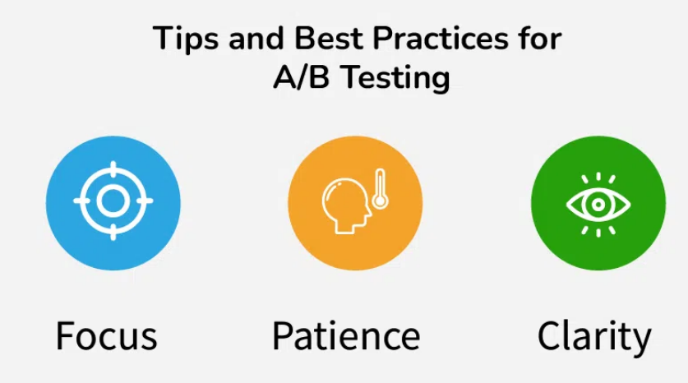

Slide 18
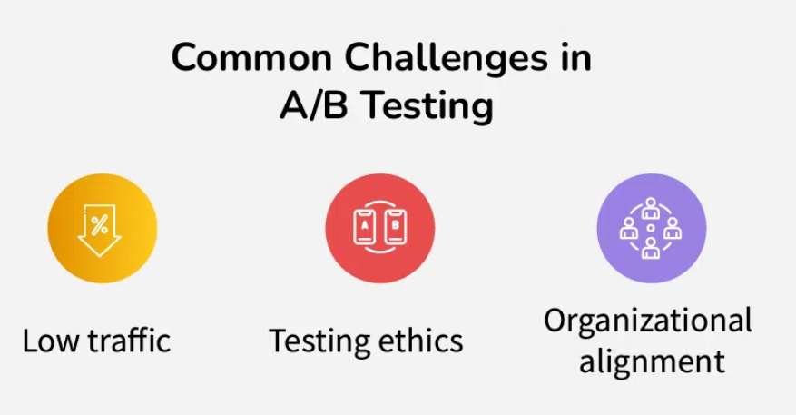

Slide 19
Managing Technical Debt in Agile Projects
Technical Debt: The cost of suboptimal code implementation.
Causes: Rushed releases, lack of refactoring, poor documentation.
Strategies: Regular code reviews, refactoring sprints, prioritization in backlog.

Slide 20
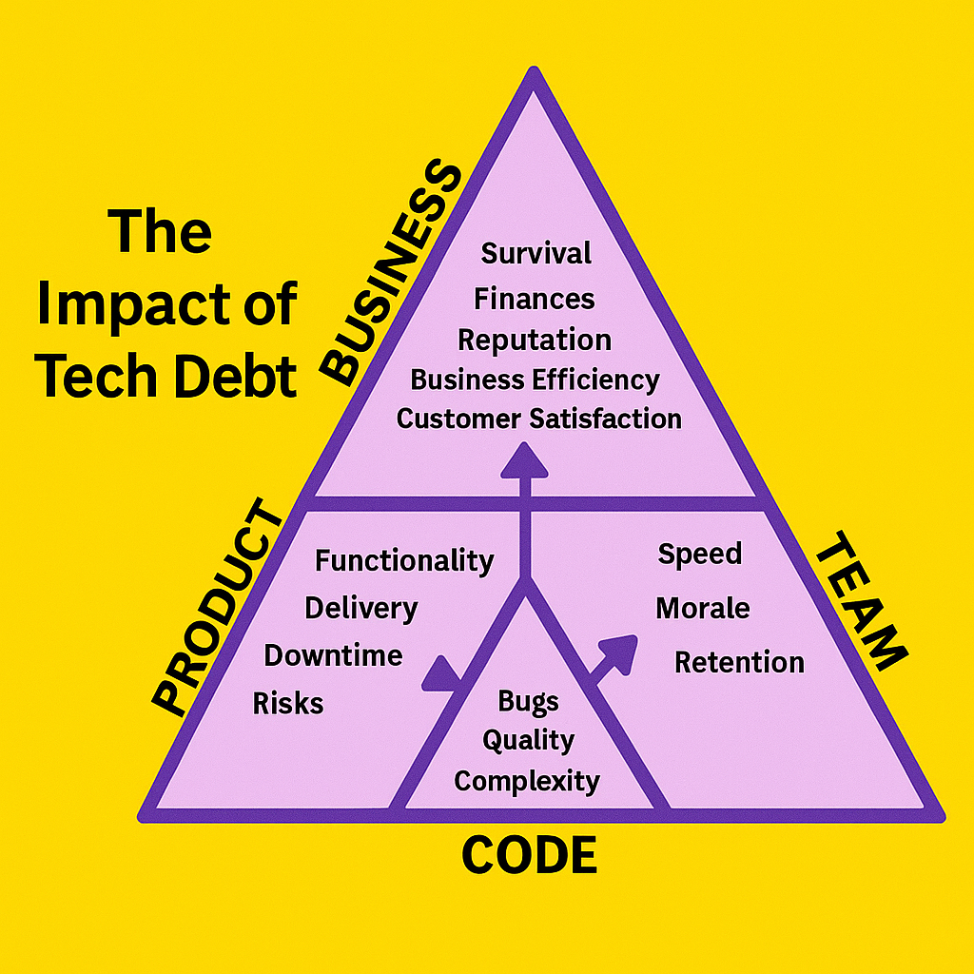

Slide 21
Case Study: Slack’s Market Fit Journey
Initial Pivot from Game to Communication Tool.
Emphasized team collaboration and integrations.
Rapid user adoption led to organic growth and PMF.

Slide 22
Case Study: Dropbox and A/B Testing
Used A/B testing for homepage design and referral programs.
Measured conversion rates and virality.
Optimized user acquisition strategies.

Slide 23
MCQs
1. What is the primary goal of product strategy?
A. Marketing
B. Aligning development with business goals
C. Customer support
D. UI Design
2. Which of the following indicates Product-Market Fit?
A. High churn
B. Declining sales
C. Organic growth
D. Fewer user sessions
3. What does KPI stand for?
A. Key Product Integration
B. Known Product Insight
C. Key Performance Indicator
D. None of the above

Slide 24
4. Which tool is best for measuring user behavior?
A. Excel
B. Google Analytics
C. Notepad
D. Paint
5. A/B testing requires:
A. Marketing Plan
B. Hypothesis and statistical analysis
C. Budget approval
D. Sales Data
6. What causes technical debt?
A. Agile meetings
B. Rapid coding with no refactor
C. Test-driven development
D. Weekly sprints

Slide 25
7. Refactoring helps to:
A. Add bugs
B. Create new UI
C. Improve code quality
D. Increase technical debt
8. Slack originally started as a:
A. Social Network
B. Game
C. Email Client
D. Calendar App
9. Dropbox used A/B testing for:
A. Branding
B. UI testing only
C. Referral program optimization
D. Hiring decisions

Slide 26
10. A good indicator of data-driven success is:
A. Intuition
B. Data logs
C. Increased retention
D. More developers
11. PMF stands for:
A. Product Mission Fit
B. Product Market Fit
C. Product Maintenance Function
D. Project Management Forum
12. Which metric shows long-term user engagement?
A. Bounce rate
B. DAU
C. MAU
D. CPM

Slide 27
13. Which of these is NOT a benefit of A/B testing?
A. Validates design decisions
B. Improves SEO directly
C. Reduces guesswork
D. Provides user insights
14. When is it ideal to analyze technical debt?
A. Only during releases
B. Never
C. Regularly during backlog grooming
D. Only at project end
15. What is a key reason to conduct a case study in product management?
A. To fill documentation
B. To evaluate real-world effectiveness
C. For marketing only
D. For employee training

Slide 28
16. What is a 'control' in A/B testing?
A. New feature variant
B. Baseline version for comparison
C. Database log
D. Marketing campaign
17. Which is an example of technical debt?
A. Well-commented code
B. Refactored module
C. Hardcoded values in production
D. Comprehensive test cases
18. Product-Market Fit means:
A. Building a market for your product
B. Your product satisfies market demand
C. You create a niche product
D. Market aligns with branding

Slide 29
19. What should be included in a product strategy?
A. Team birthdays
B. User login stats
C. Vision, goals, roadmap
D. Customer emails
20. Which approach helps identify the most useful product features?
A. Customer support queries
B. Analytics and A/B testing
C. Executive meetings
D. Manual testing

